Slide 1
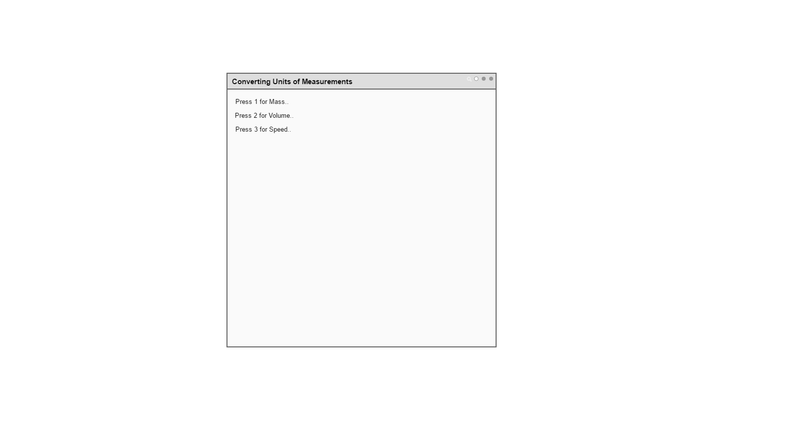
Part 1: Design UI Command Line

Slide 2
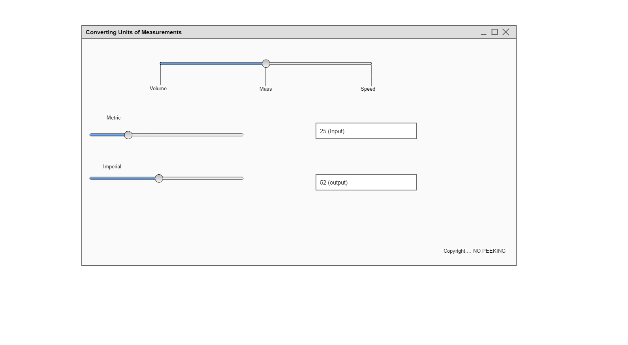
Part 2: Design GUI

Slide 3
IPO Chart

